Slide 1

过关测试卷
模块八 第三章 测试卷

Slide 2
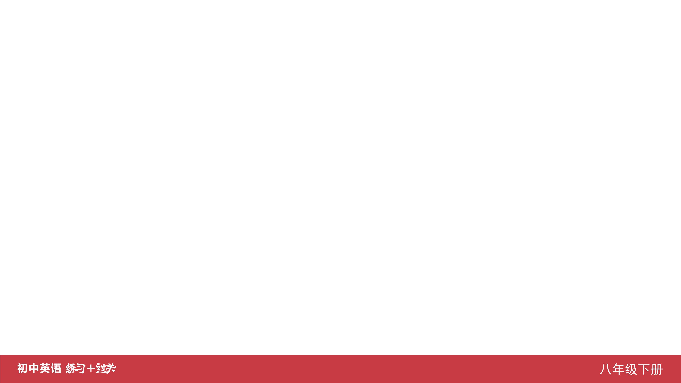
Ⅰ. 听力
1-5 ____________
6-10 ____________
11-15 ____________
16 ____________
17 ____________
18 ____________
19 ____________
20 ____________
BCBCA
CBBBC
BABCA
Suits
nurse
jeans
two/2
easy

Slide 3
Ⅱ. 选择填空
21-25 ____________
26-30 ____________
31-35 ____________
CBCBC
BCAAB
CABCB

Slide 4
Ⅲ. 完形填空
36-40 ____________
41-45 ____________
BAABA
BBABC

Slide 5
Ⅳ. 阅读理解
46-50 ____________
51-55 ____________
56-60 ____________
61-65 ____________
66-70 ____________
ADBCD
BDBAC
BACDA
CCADD
BAECD

Slide 6
Ⅴ. 情景交际
71. _____________________________________________
72. _____________________________________________
_____________________________________________ 73. _____________________________________________
74. _____________________________________________
75. _____________________________________________
_____________________________________________
Do you know when the fashion show will start/begin?
I had a good time/great fun at your birthday party last night, Ann.
Excuse me, where can I buy/find sportswear?
What is the third model wearing?
What a nice dress!/
How beautiful the dress is!

Slide 7
Ⅵ. 看图写话
76. ____________________________________________
____________________________________________
77. ____________________________________________
78. ____________________________________________
79. ____________________________________________
80. ____________________________________________
Jim is doing online shopping now./
Jim is shopping online now.
There is a swimming pool in the community.
They watched a fashion show (on TV) yesterday.
The scarf is made of silk.
The girl/She is designing a dress.

Slide 8
Ⅶ. 短文填空
skill
better/well
person
For
friends
81 ____________
82 ____________
83 ____________
84 ____________
85 ____________
usually
them
a
Through
how
86 ____________
87 ____________
88 ____________
89 ____________
90 ____________

Slide 9
Ⅷ. 书面表达
Boys and girls,
Tomorrow we’ll
That’s all. Thank you.
Students’ Union,
June 17th
go to a fashion show. All of us must be at the school gate before 8:30 a.m. We’ll go by bus. On the show we can watch many models model the clothes in different styles. The models are from different countries. Please remember to take your notebooks and pens with you. During the show, you can write down anything you think is interesting or important. After the show, we’ll have to write a report and hand it in next Monday.

Slide 10


